Slide 1
Game: When u can run but you can't hide
Game Designer: Joan Amaury Rosario
Game Producer: Prof. Michael Klein

Slide 2
Game Description
Dude needs to collect paper before he is caught
Story: you used to be a worker for this lab deep underground that was supposedly working to rehabilitate criminals. You end up missing a week of work due to a family member growing tremendously sick with the frustration of your superiors who always seemed untrustworthy and malicious. On the sixth day of you being away from work, your phone(specifically made for the scientist at the lab) rings that there was an incident at the lab, and you need to recover super important documents. You exclaim that someone else more authorized should be handling this, however, you are forced to do their bidding when they mention the life of your family is at stake. As you are being told this by your superior, 6 armed men get out of a black van and park outside your house where you reside with your family. You then know that you must do this or else this company will erase you and your family from history.

Slide 3
Start screen
Needs start button, volume sidebar on menu, controls panel, and quit button
dark background with title
Controls menu
Active scenes (start scene, game scene)

Slide 4
Gameplay
The game starts with the player reaching an excavation site where the entrance to the lab is located.
The player must collect documents found outside before entering the lab.
Documents can be collected by clicking on them. Player will be able to use flashlight.
Documents are stored in inventory; player can access documents for story details

Slide 5
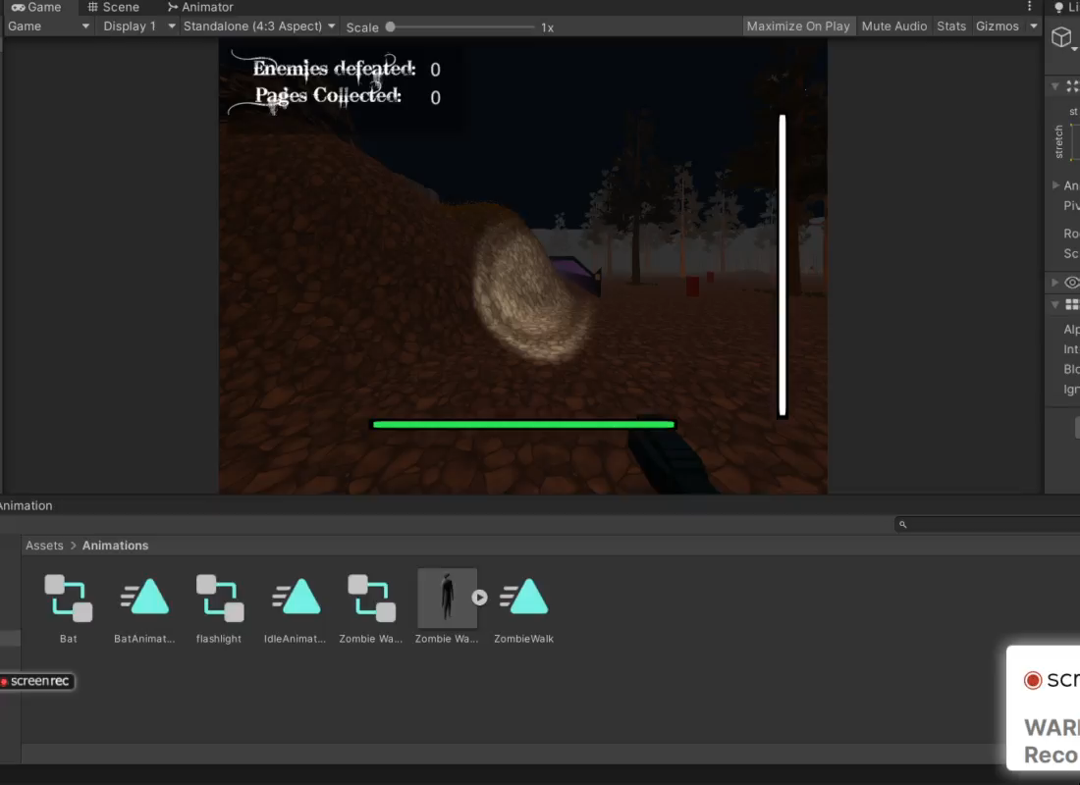
Gameplay pt 2

Slide 6
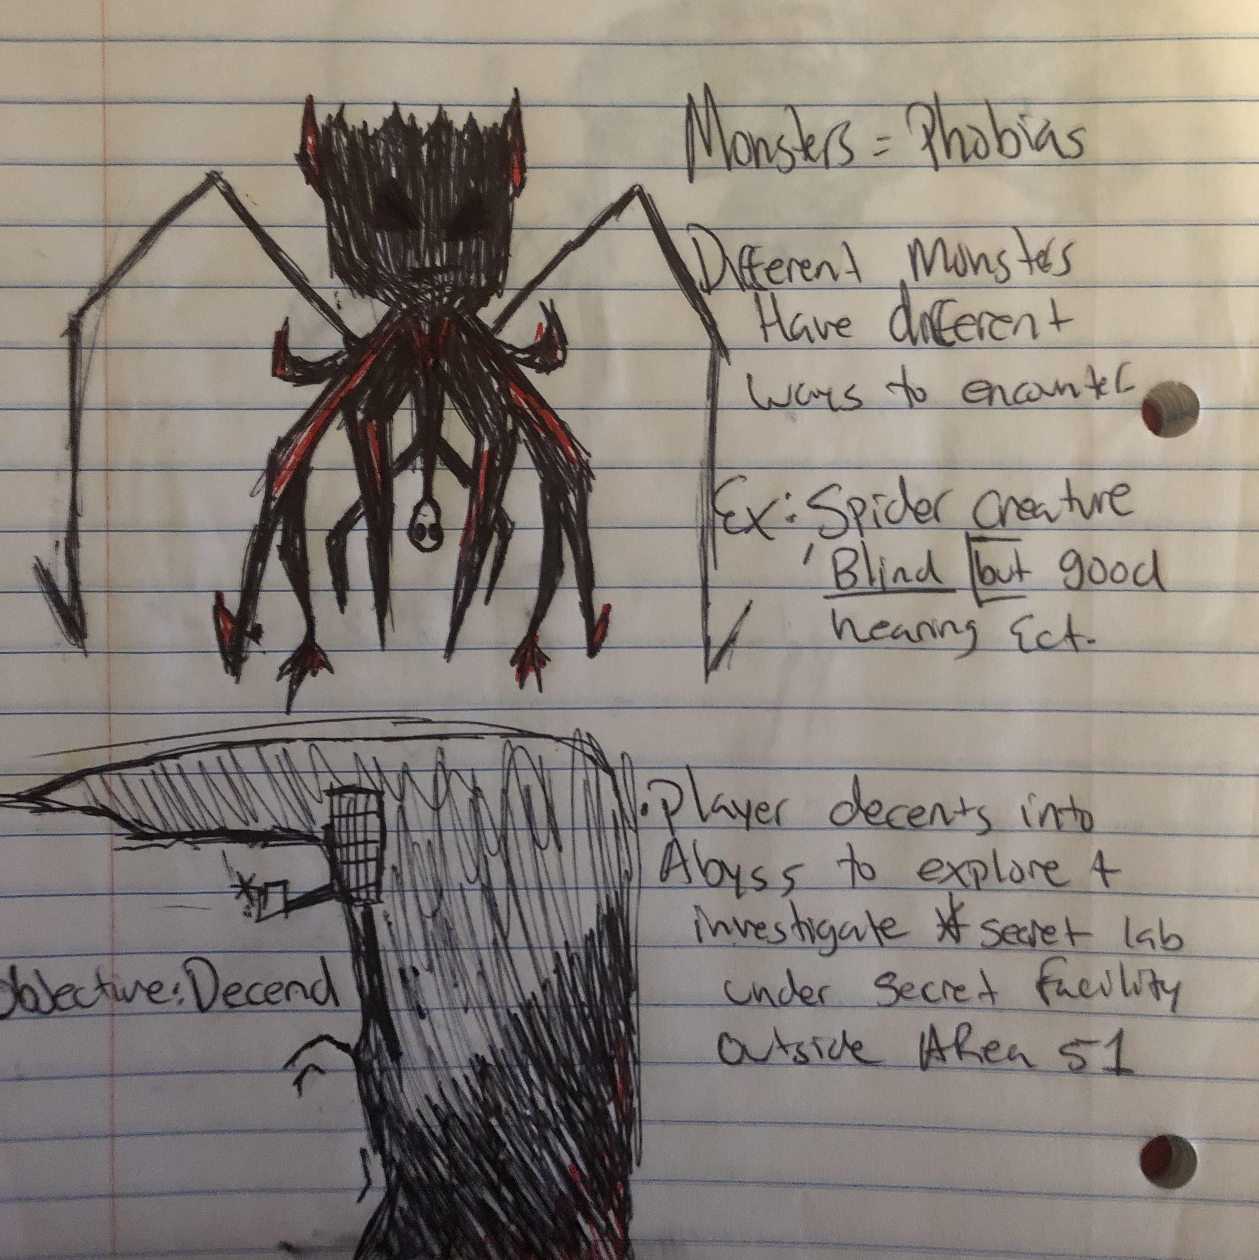
Enemies
Phobia based monsters:
Entomophobia: fear of insects.
Ophidiophobia: fear of snakes.
Cynophobia: fear of dogs.
Astraphobia: fear of storms.
Tarantula creatures
Giant humanoid aliens
Fish Land monster
Hollow creature

Slide 7


