Slide 1
Game: Name Undecided
By: Jeffrey Sickles

Slide 2
What Is My Game About?
My game takes place on Earth in current time but aliens have advanced far past the human race and have weaponized planets. Aliens have made it close to earth and are building their new weapon on the moon, during their experiments they shocked the Earth with immense electricity causing an intense lighting and rain storm shocking many people on Earth and killing many. People that are left are fighting for survival in this post apocalyptic wasteland where there are now two factions. The evil faction fighting to take over Earth corruptly are called the “Elementals” but the good faction refers to them as “The Corrupted”. The Elementals want to take over Earth and rule it for there own making their citizens work for them unjustly. The good faction also known as the “Empowered” want to rebuild Earth and make it even stronger and one day even hope to work with the aliens to develop technology to help them rule multiple planets if possible. A huge aspect of my game is the fact that some people when the storm hit were electrified in a way that they gained electric powers which the Elementals use for bad and the Empowered use for good.

Slide 3
What Is The Objective Of My Game?
The objective of my game is for the main character which is going to be called “Spark” to roam around the map and collect sparks to build his powers greater so one day he can eliminate the Elementals and rule Earth in a way that is fair to the people and rebuild Earth to what it used to be and better.

Slide 4
How Is The Game Going To Work?
The game is going to revolve around the main character named spark which he is going to be moving around the map trying to avoid mutated enemies that are roaming around the map. These mutated enemies work for the Elementals and are going to make it their goal to stop Spark. Spark is going to be moving throughout the map looking for crystals that are blue that will increase his power when he picks them up, finding all of these crystals will give him the power to take down all of the Elementals.

Slide 5
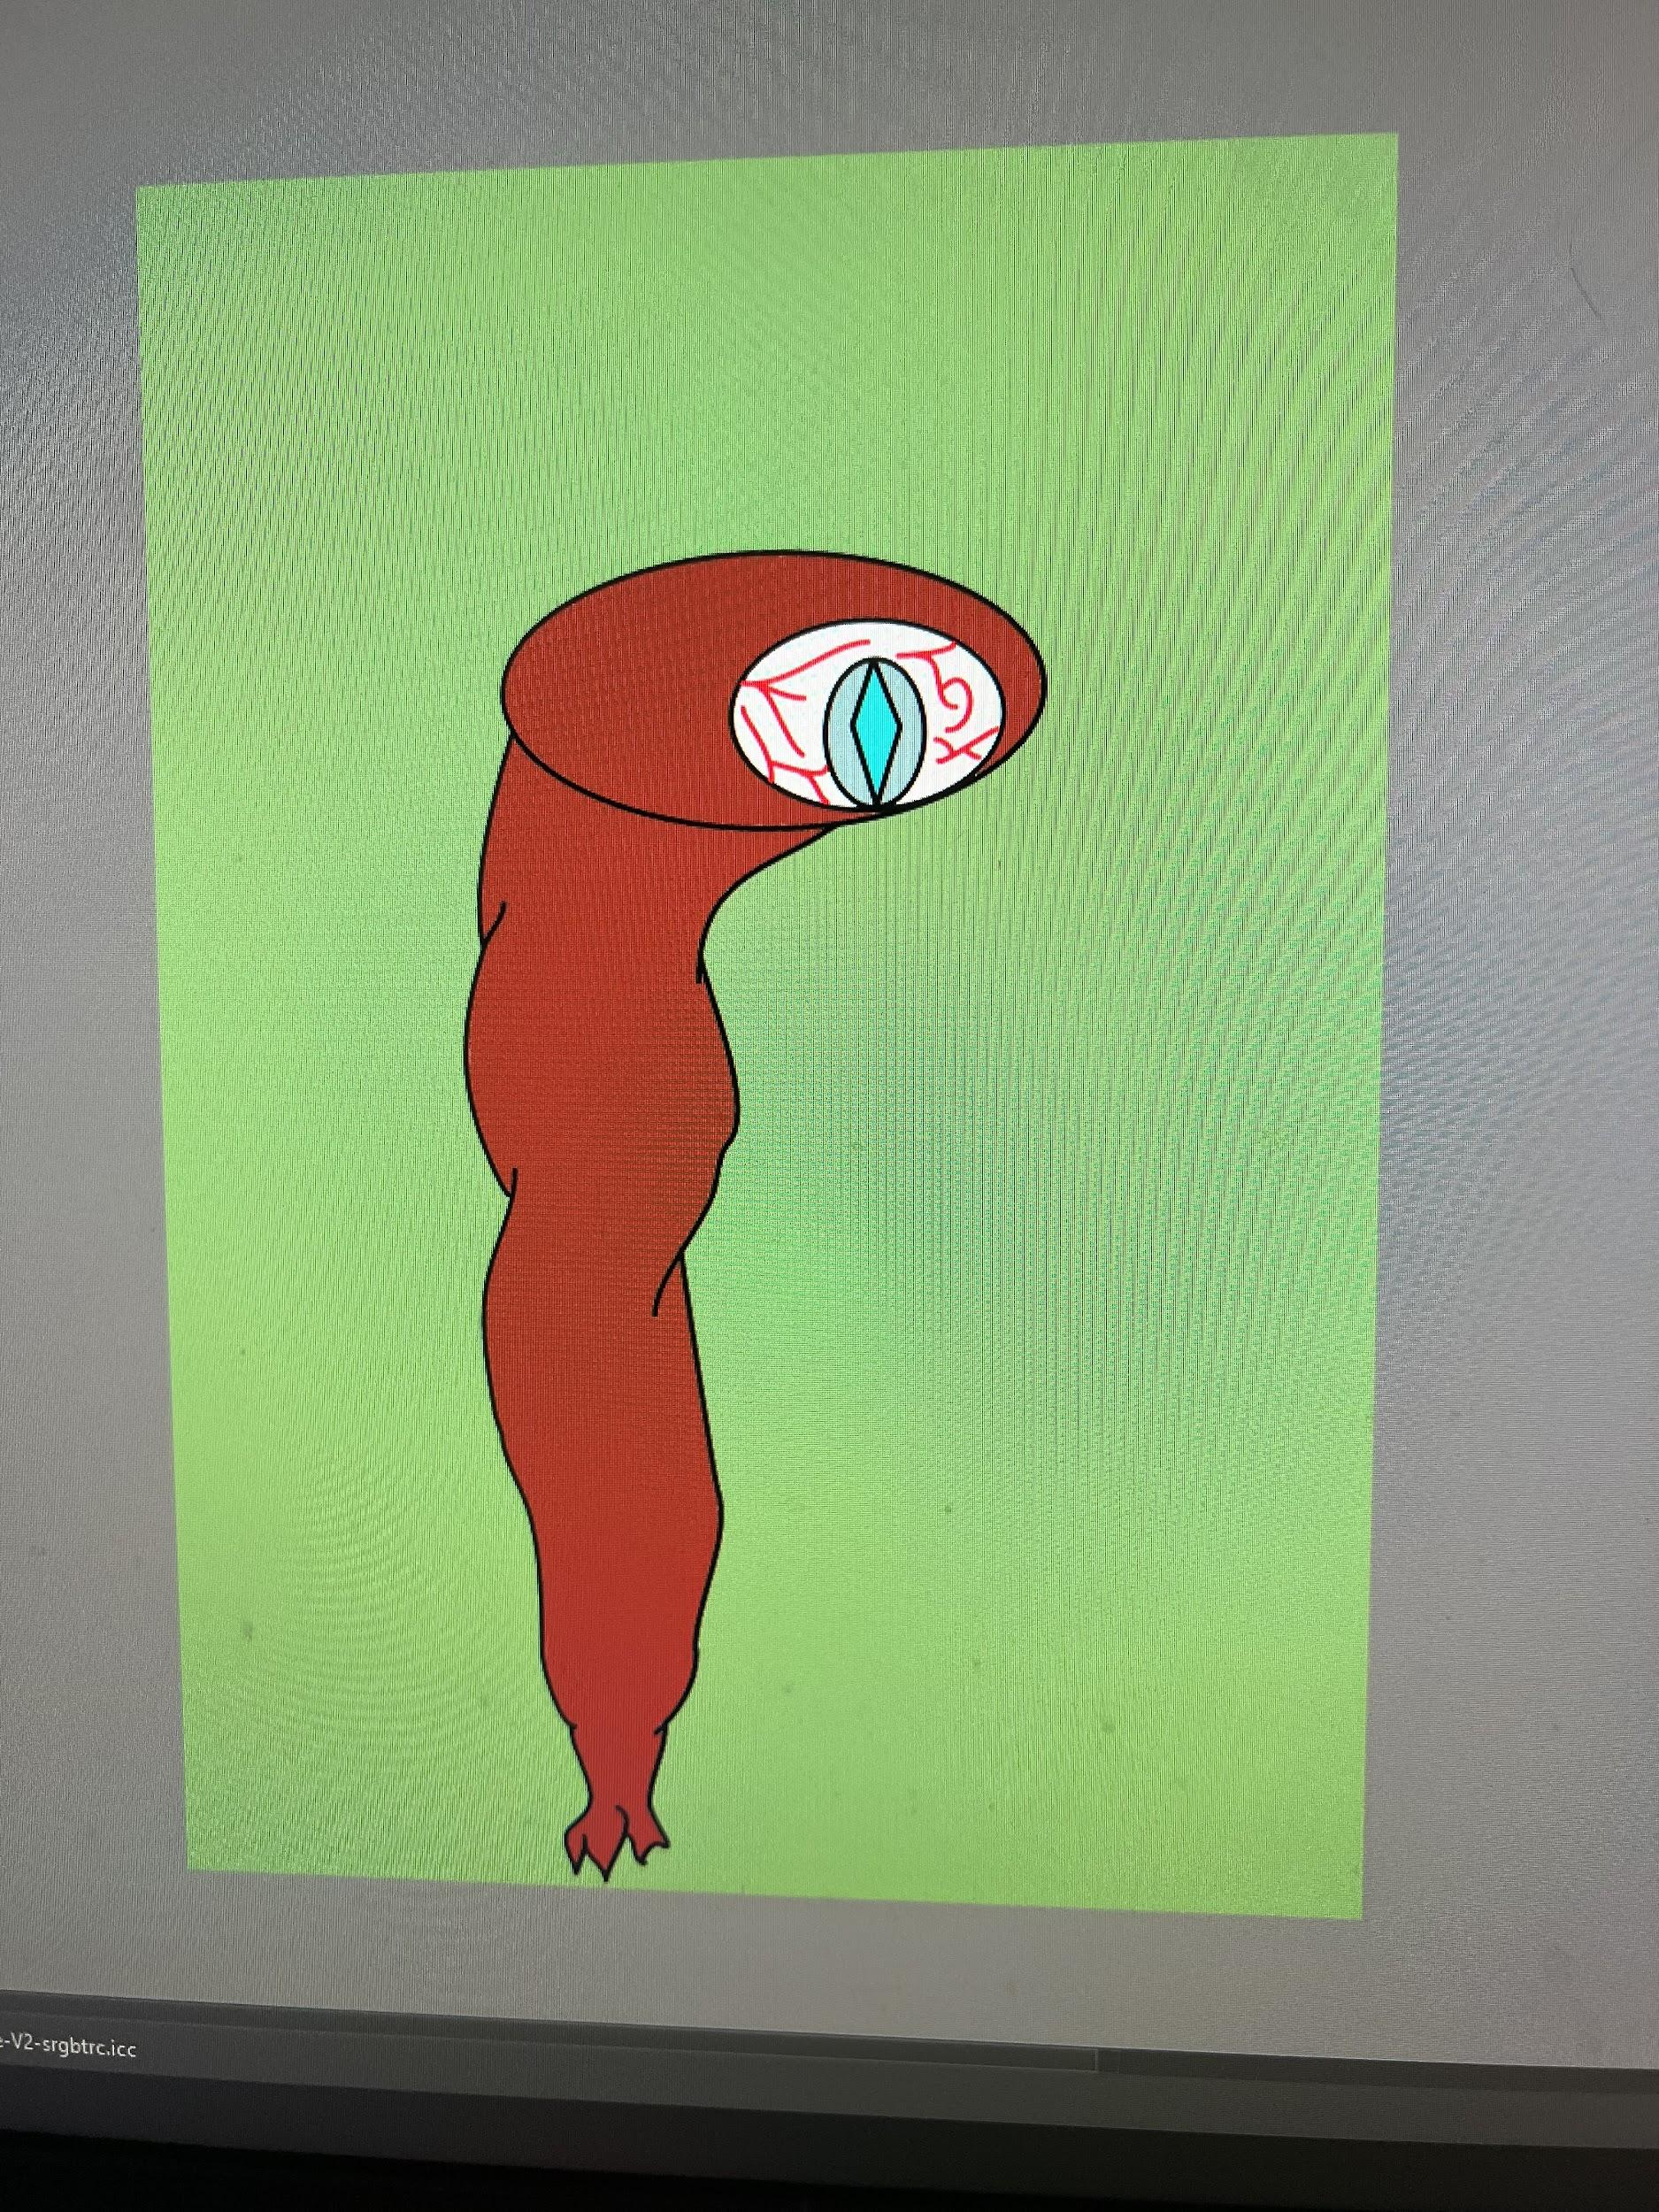
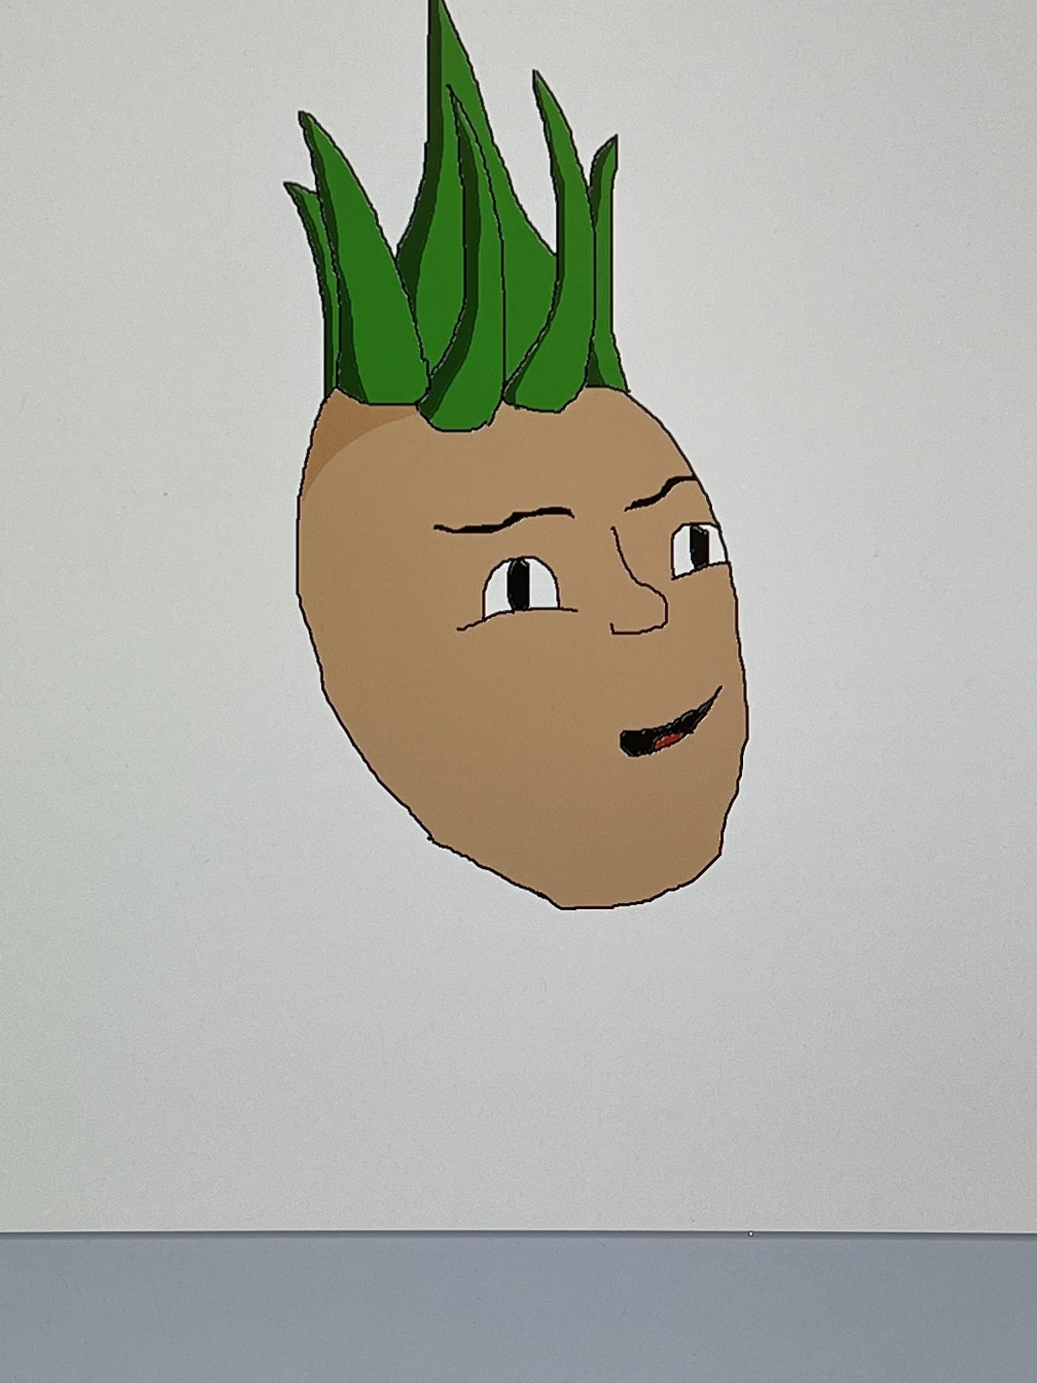
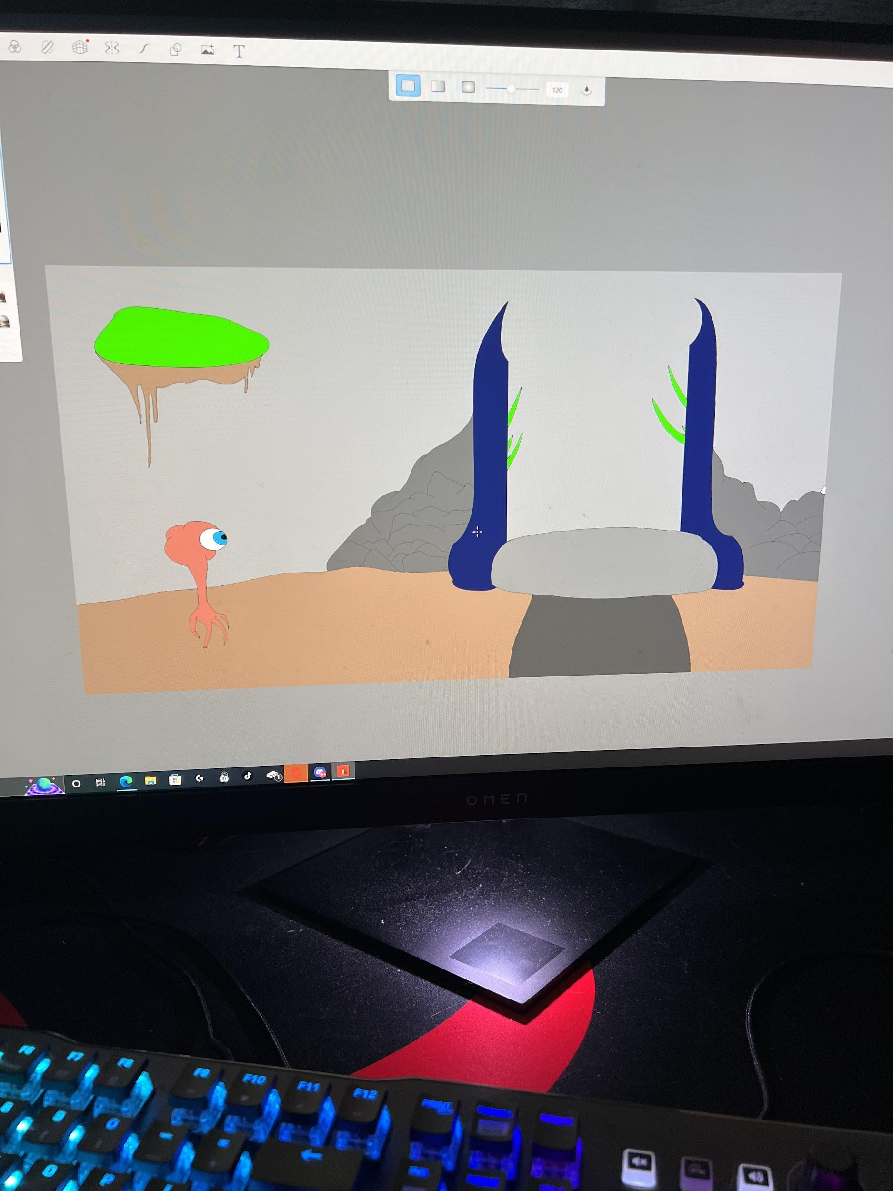
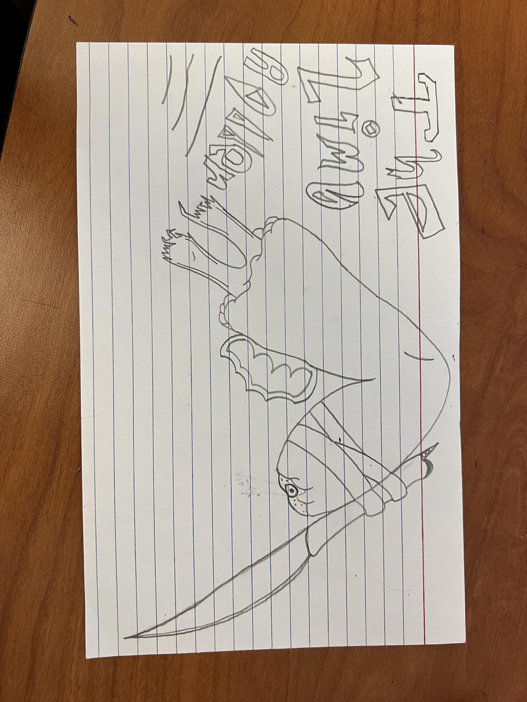
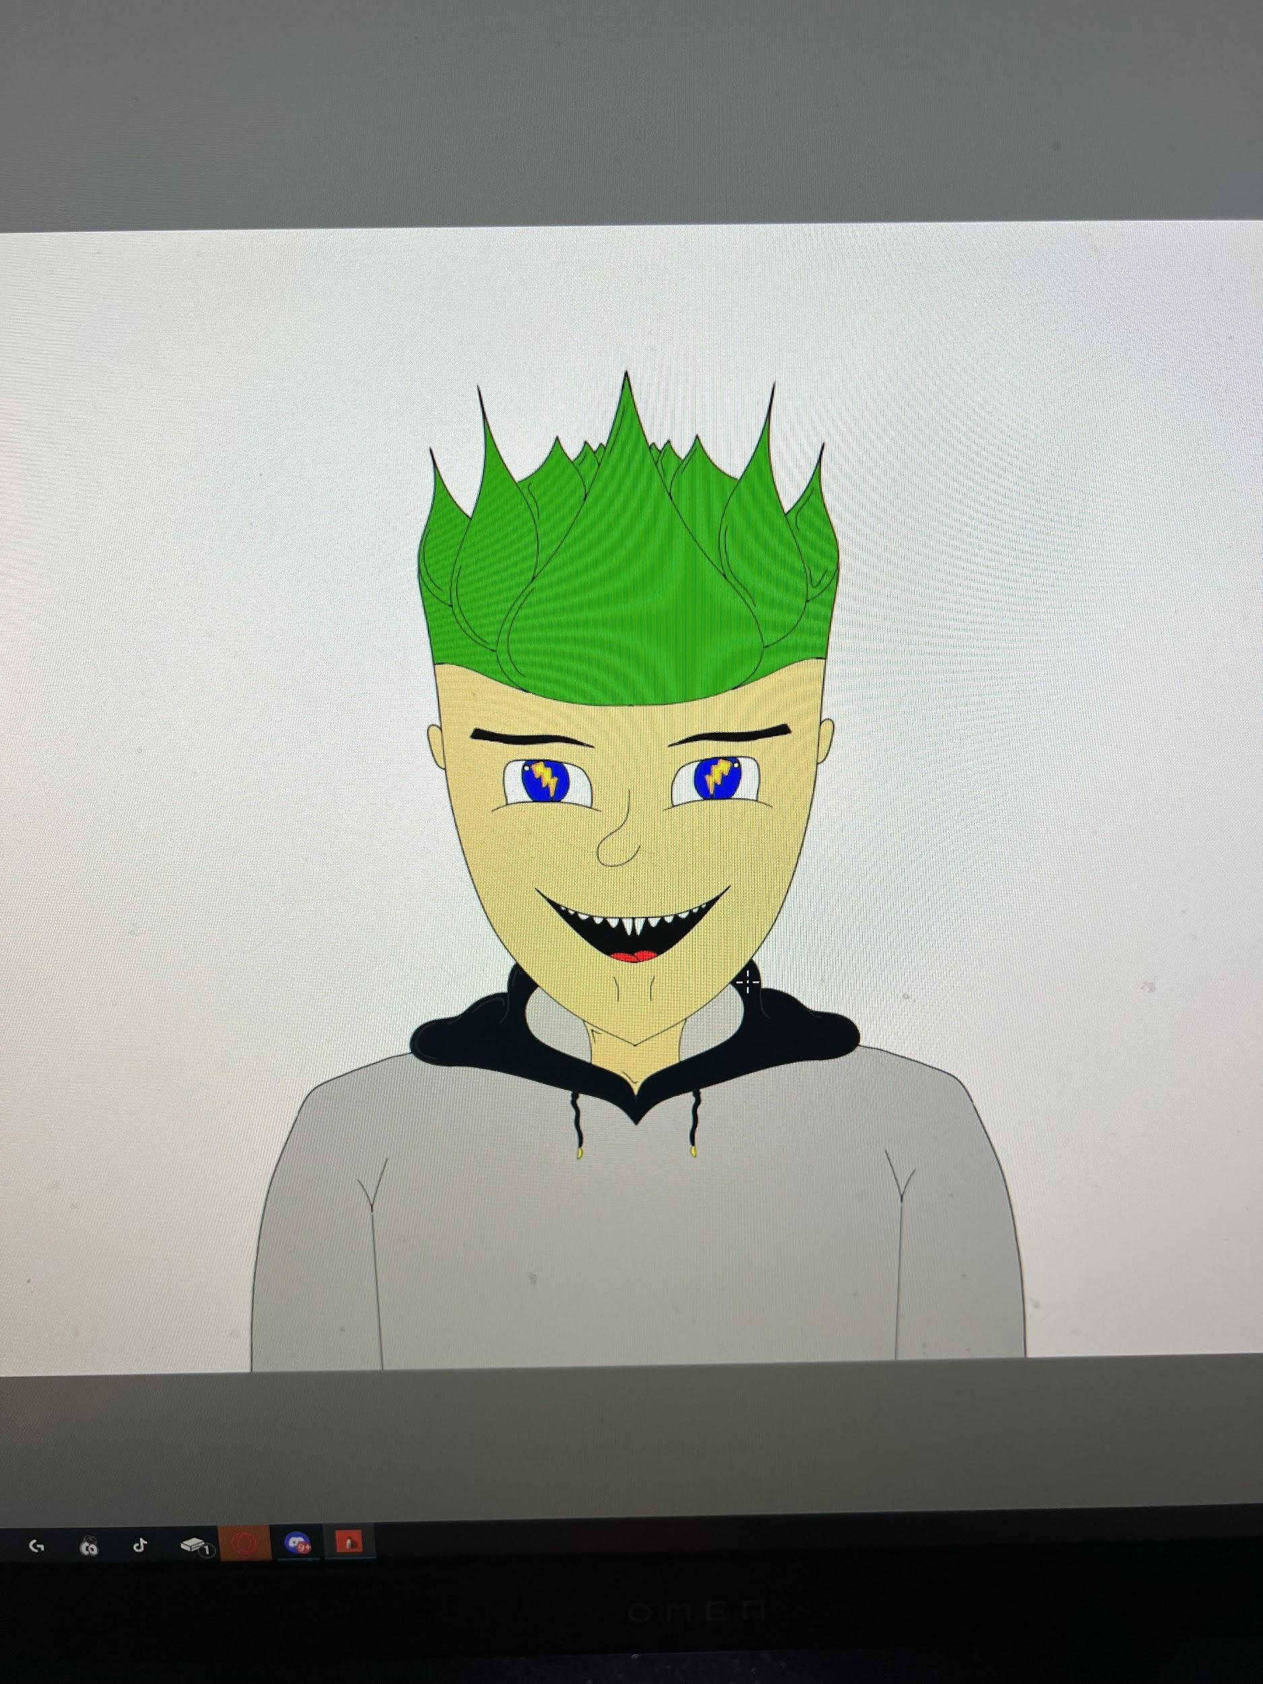
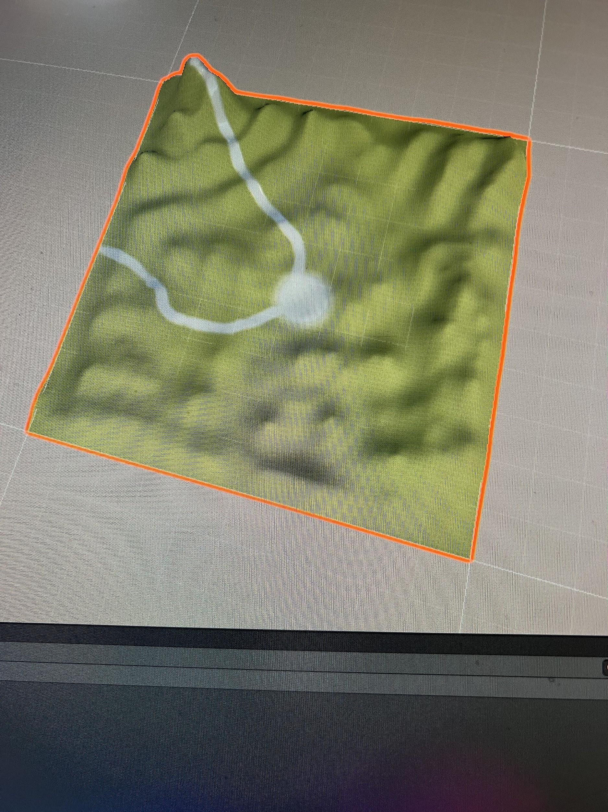
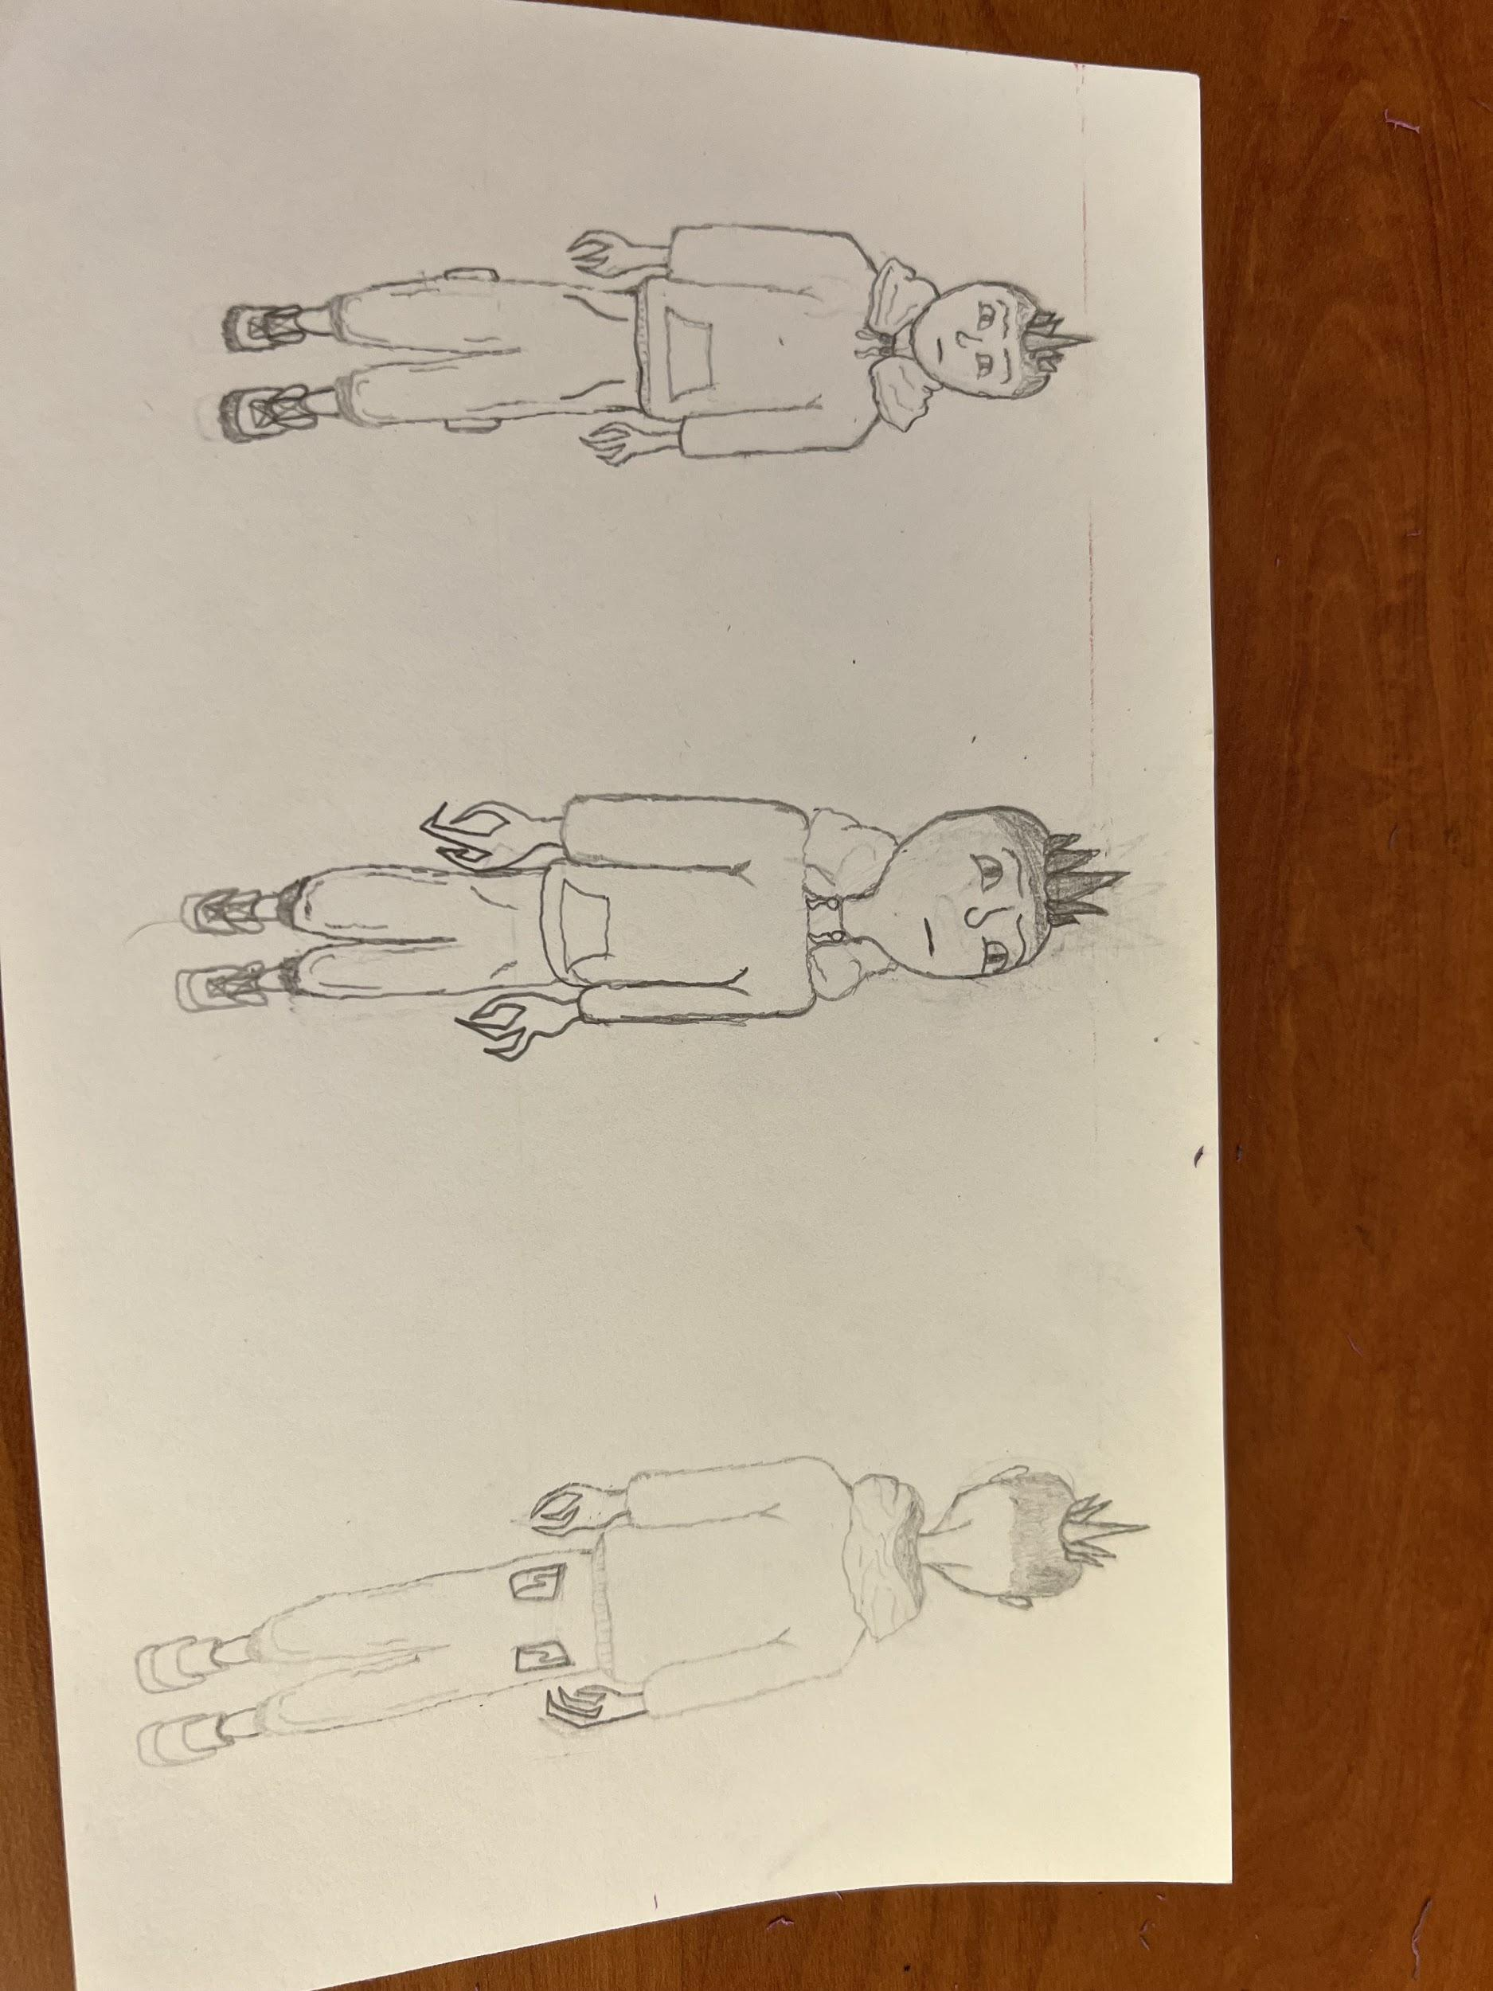
Images I Have Been Working On

